Slide 1
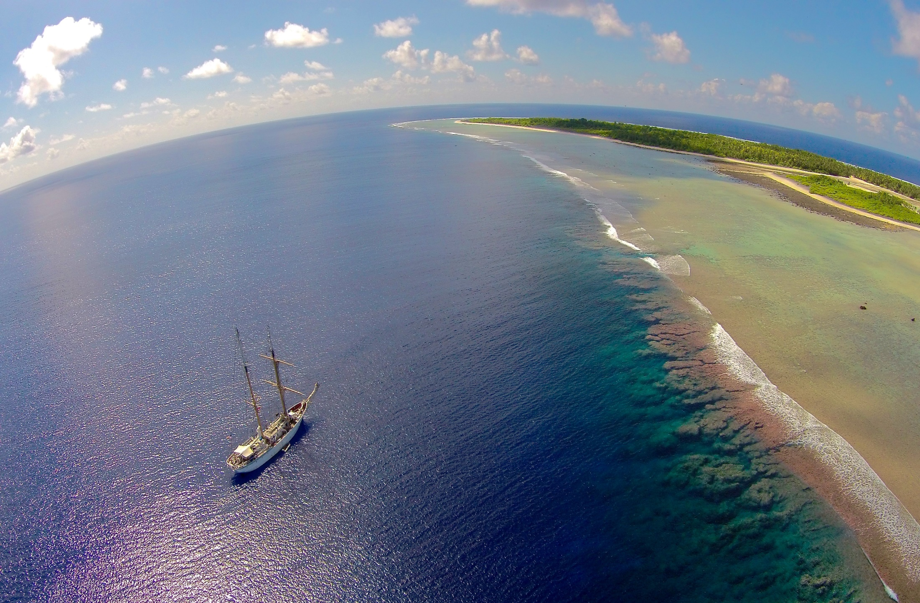

Grand Challenges For Equatorial Oceans and Reefs
Barbara A. Block & Fio Micheli
Stanford University
Earth Warming
Ocean Deoxygenation
Ocean Acidity

Slide 2
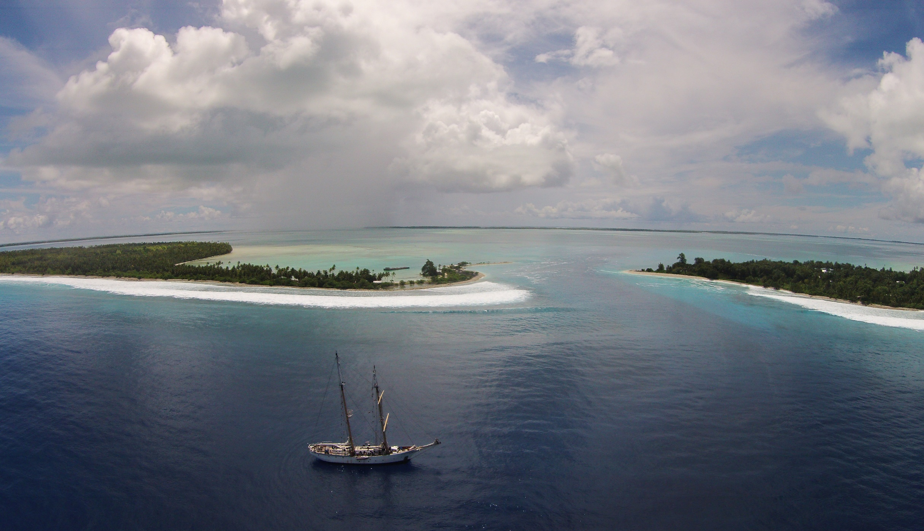
We Were Just In the Line Islands
Surveying Oceanography and Reefs
Robert Seamans at Fanning Island June 06, 2015

Slide 3
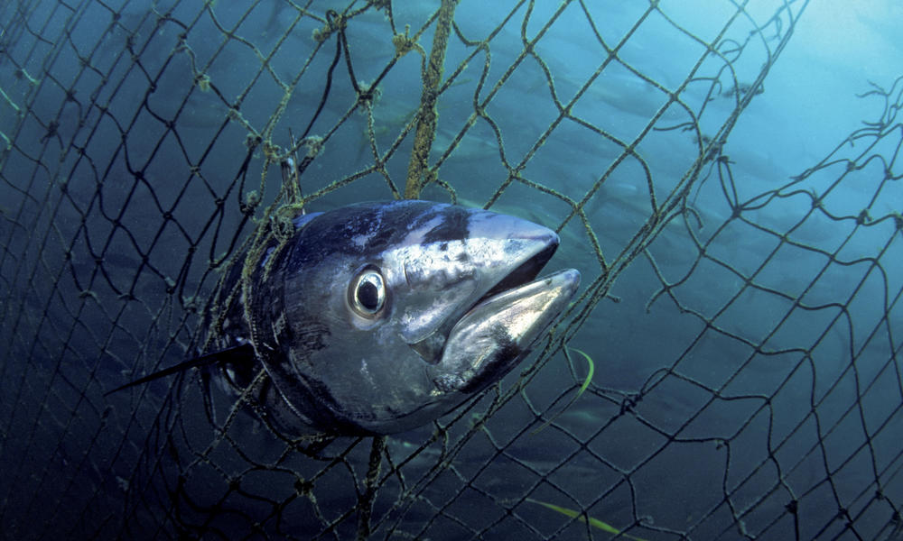
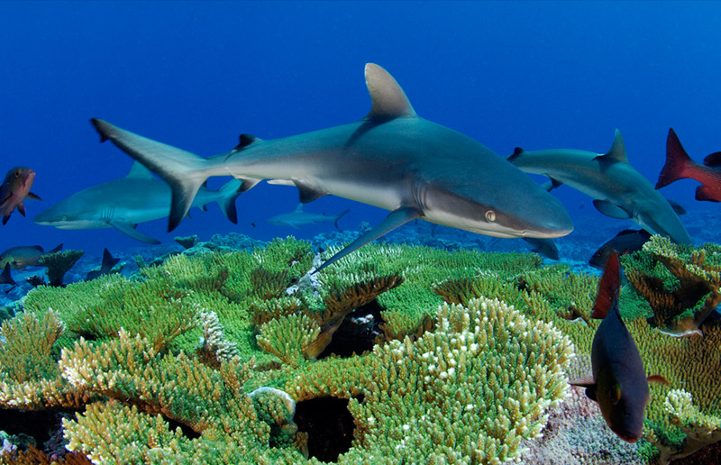
We Study Stress on Our Ocean Ecosystems
FISHING
Overexploitation
By-Catch
Habitat Degradation
CLIMATE CHANGE
Thermal, pH, CO₂
Hypoxia, Acidity
Stress, Disease
Sea Level Rise
Habitat Loss
-
Notes:
Oceans are under intense pressure to satisfy expanding demands tue to population growth
Climate Change poses unknown threats to marine Ecosystems
Requires monitoring

Slide 4
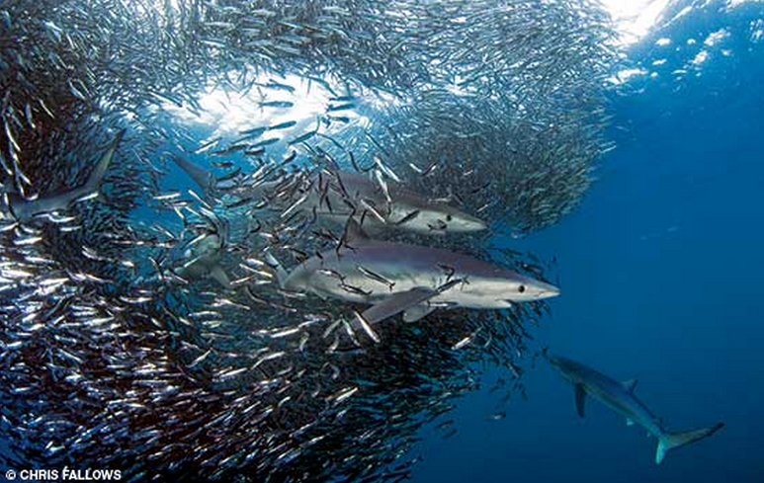
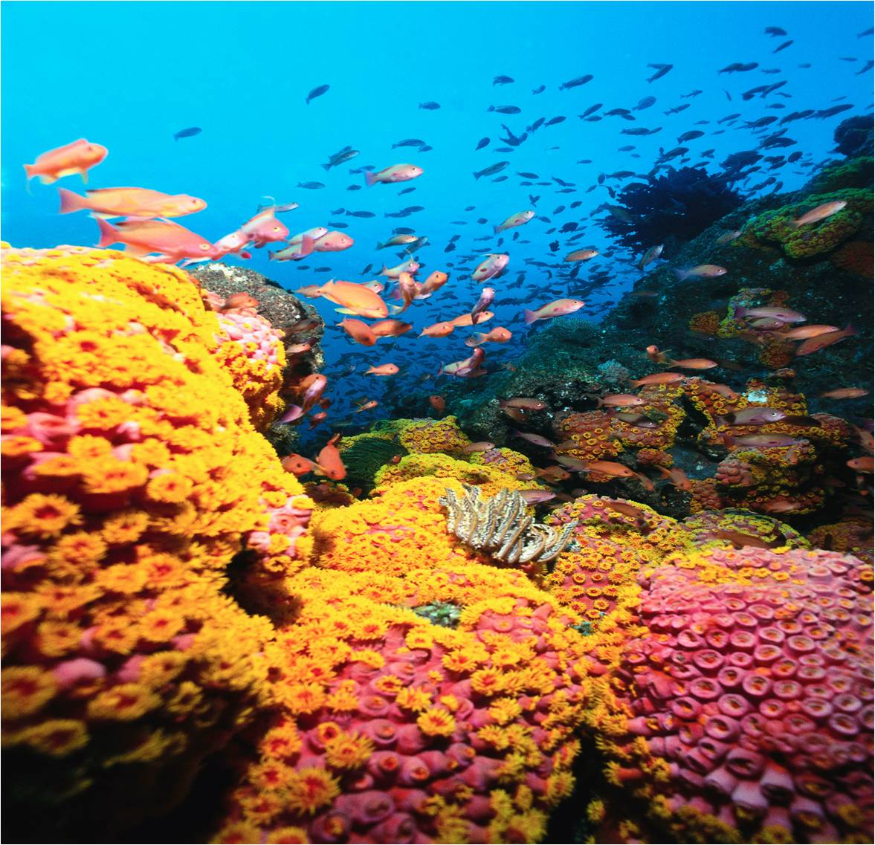
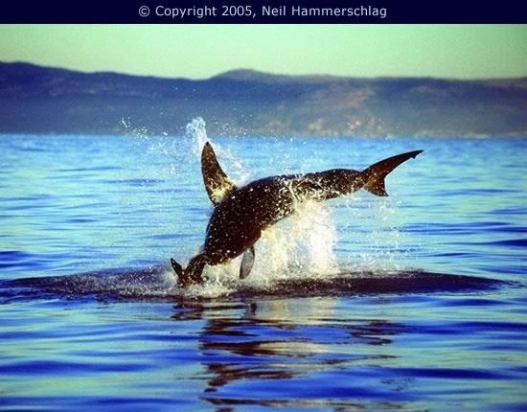
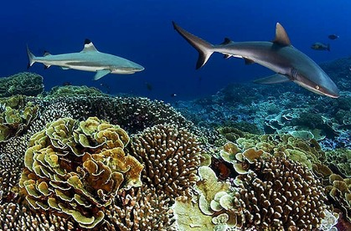
Challenges for Marine Protected Areas Everywhere
How Will We Know When Our Seascapes are Changing?
Notes:
4
Ocean Ecosystems are Vastly complex, dynamic environments. Difficult to Understand the Nature of Stability, Trophic linkages and Energy Flow

Slide 5
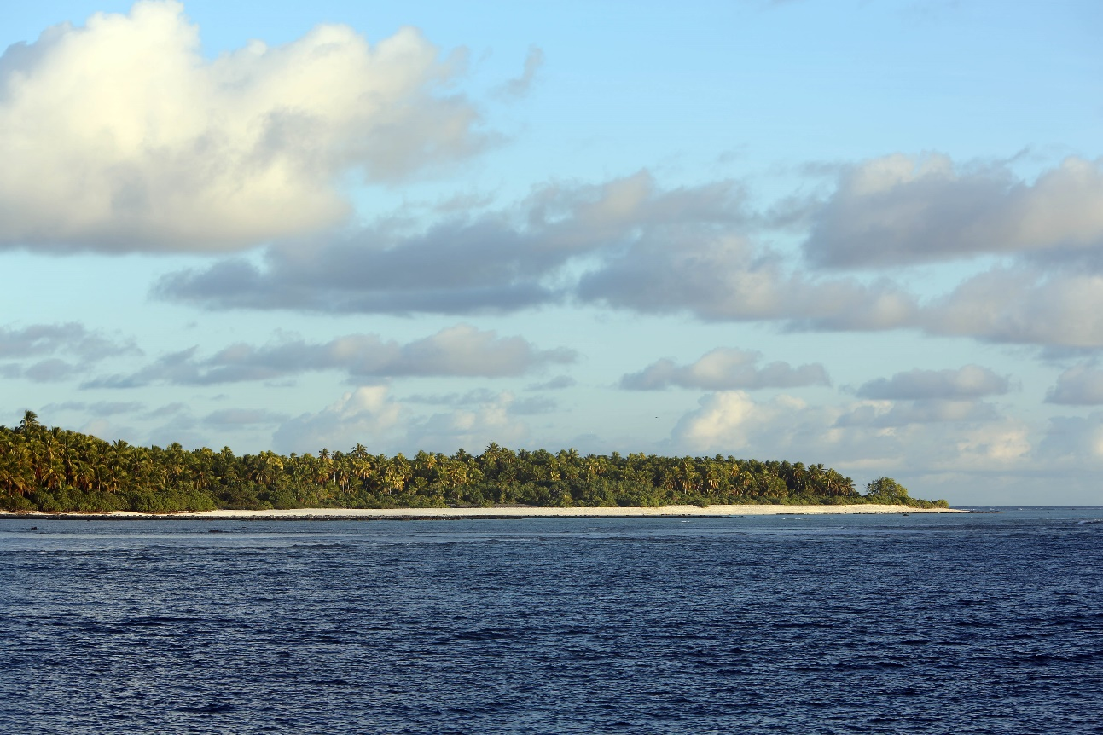
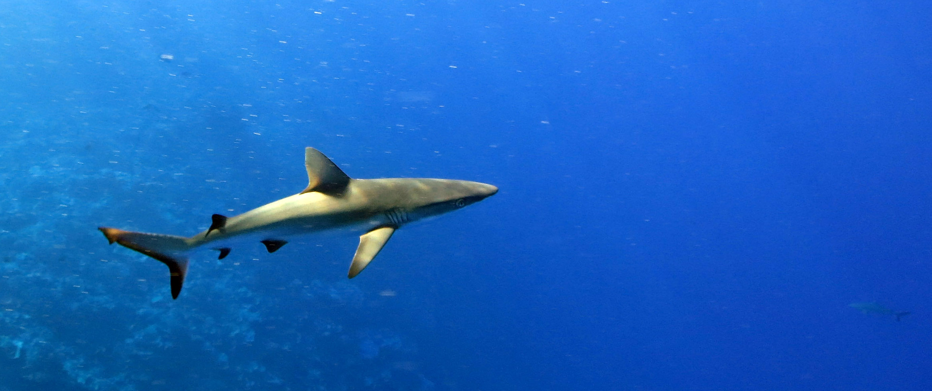
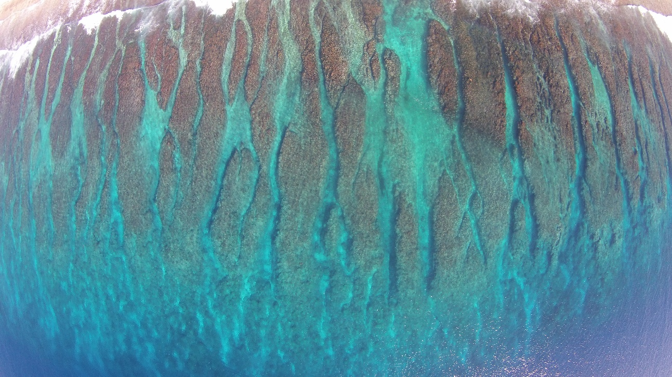
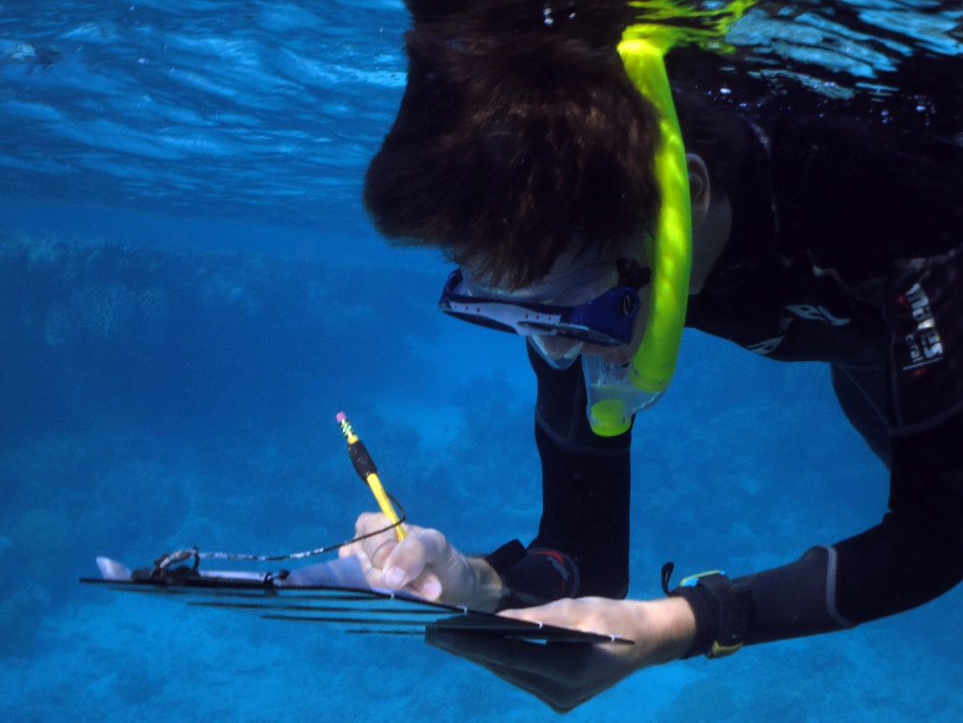
Can We Measure Resilience? Line Islands
Are Diverse Islands/Atolls with Numerous Conditions

Slide 6
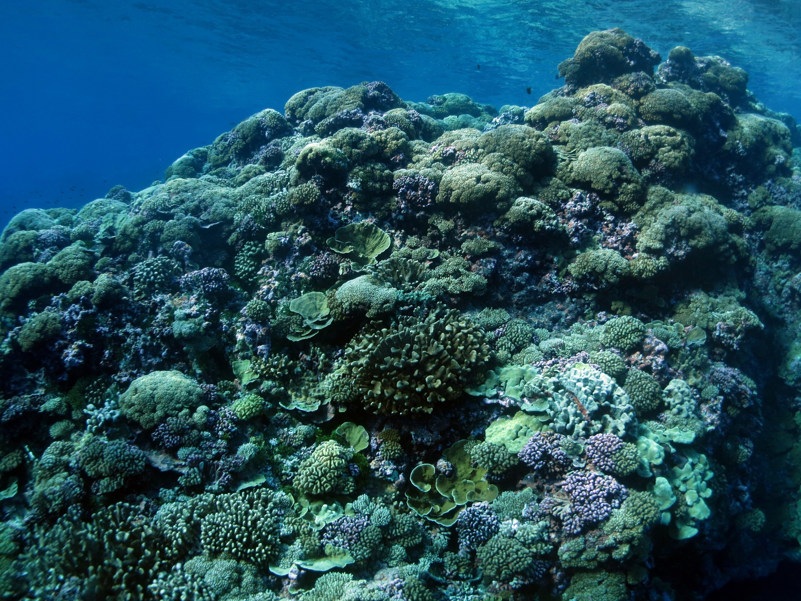
Caroline/Milleneum Atoll

Slide 7
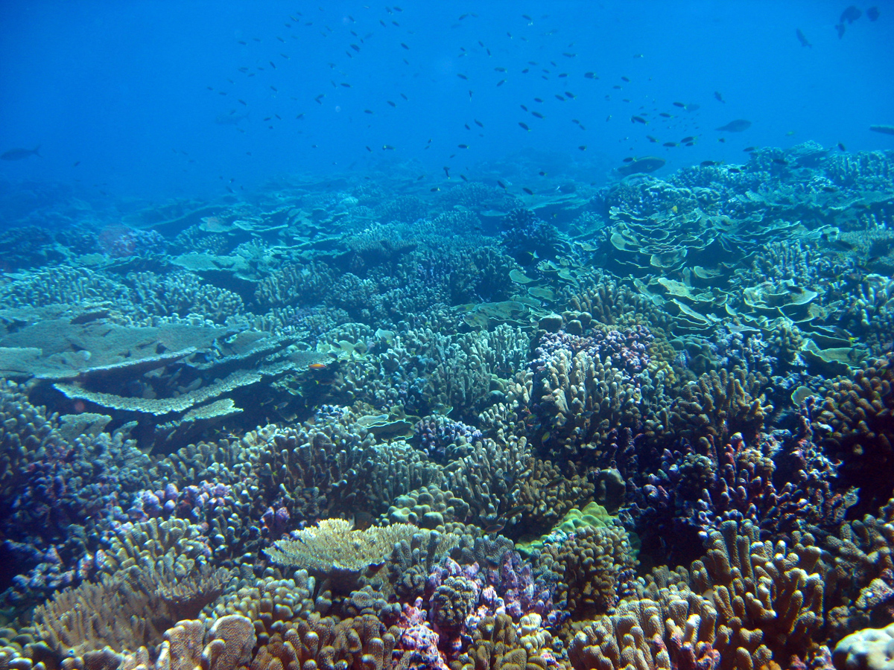
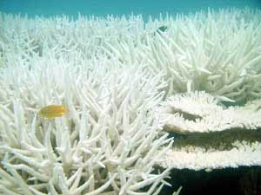
Warming and Coral Reefs
Warming water:
1°C makes a difference
Increased bleaching can be expected
Notes:
7
Beyond warming we have the problem of the oceans getting more acidified,
an already measurably so
and already affecting animals
Now, In the laboratory if you take a clam and you put it in a pH 8.1, the normal pH of seawater 7.5 it dissolves in about3 days, Put a sea urchin larvae in 7.1 it becomes deformed and dies.
Already coral reefs are growing slower in some places and already larvae are dying

Slide 8
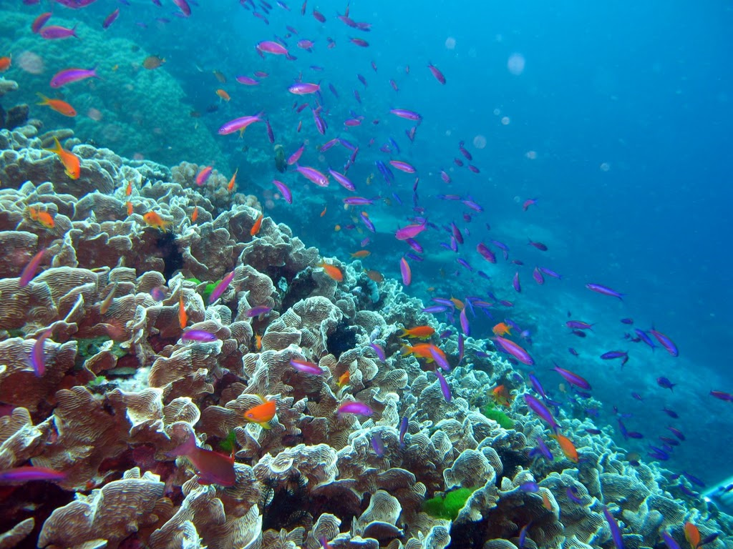
How will we know
When our oceans
Become more acidic?
Long Term Monitoring

Slide 9
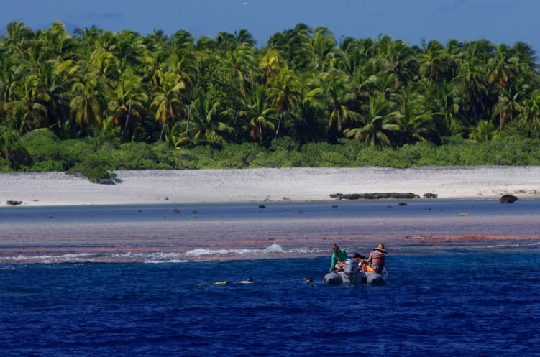
We Just Collected Intensive
Genomic Background Samples for Measuring Resilience and Monitoring

Slide 10
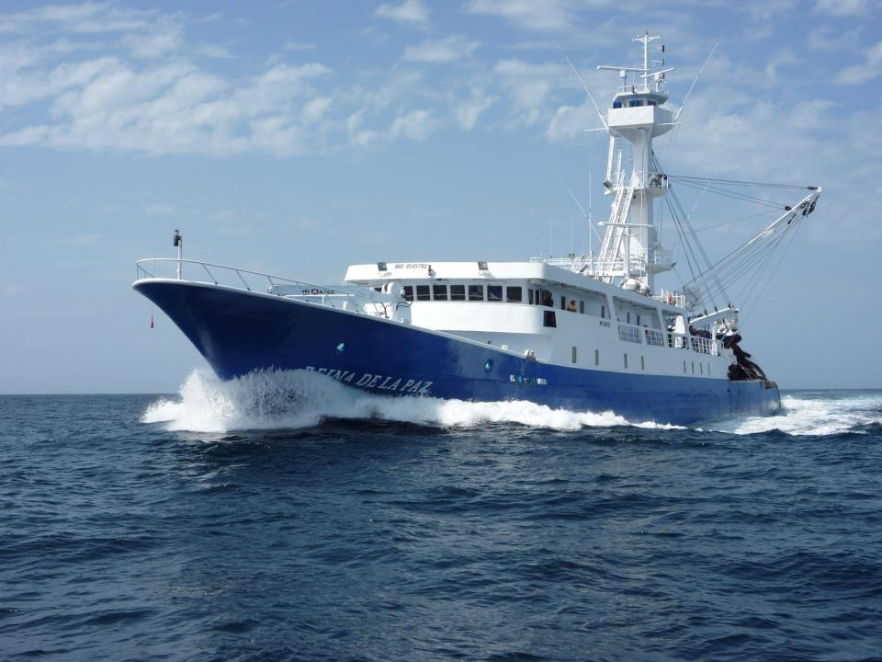
Will Protections for Tunas Increase
Local Production?
Notes:
The Global hunt for bluefin is relentless- every where they swim they are pursued- it is the last Gold rush on Earth

Slide 11
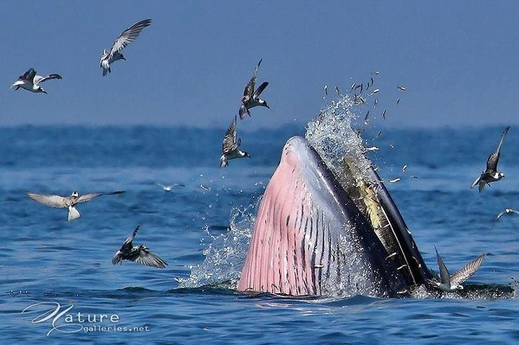
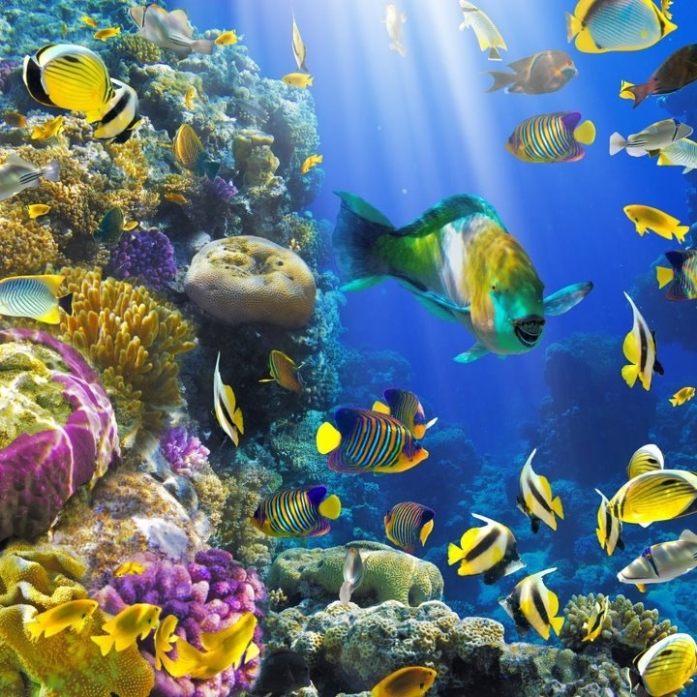
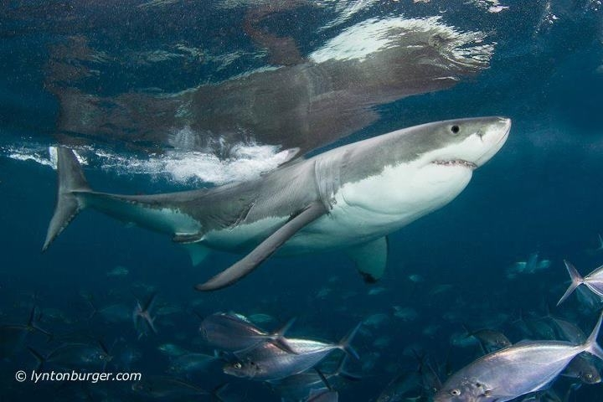
Healthy Ocean Ecosystems Require Predators

Slide 12
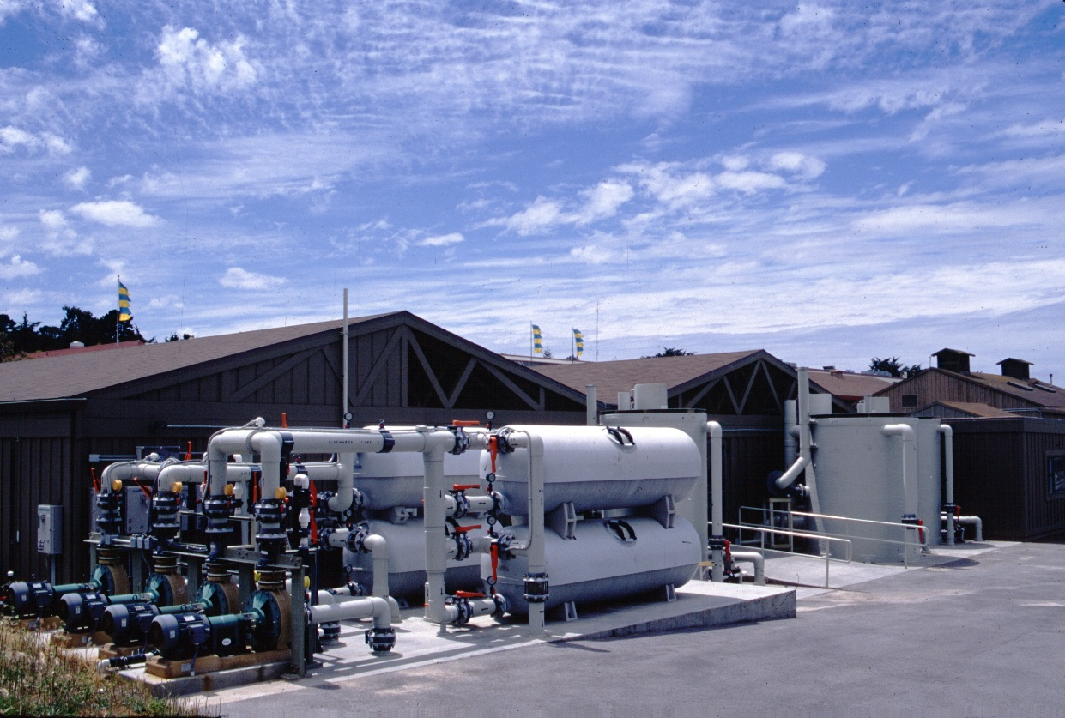
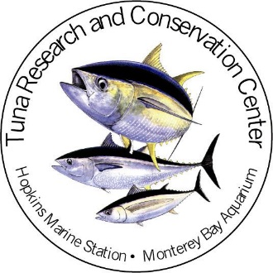
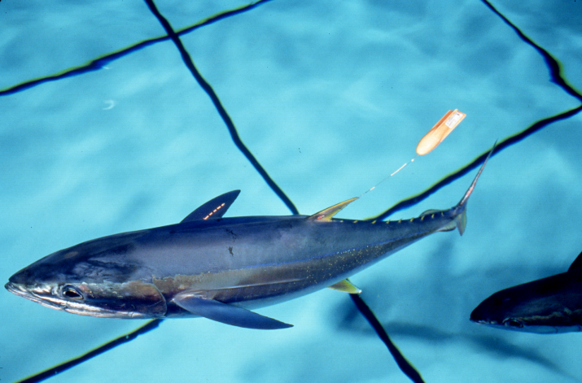
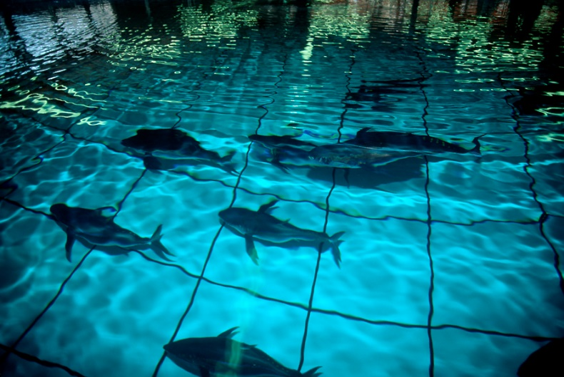
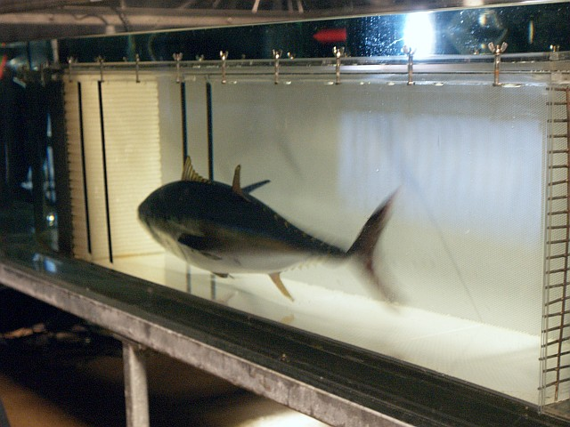
Tuna Research & Conservation Center
Large on Land Tuna Facility:1994-2014

Slide 13
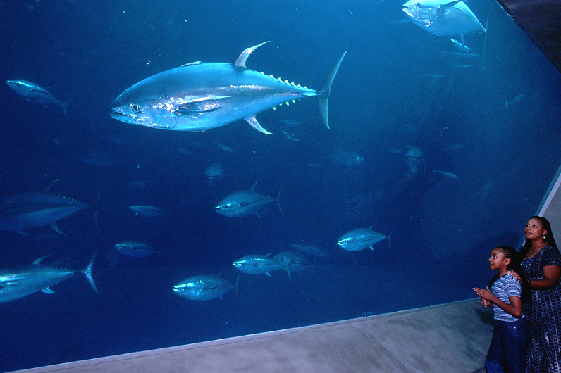
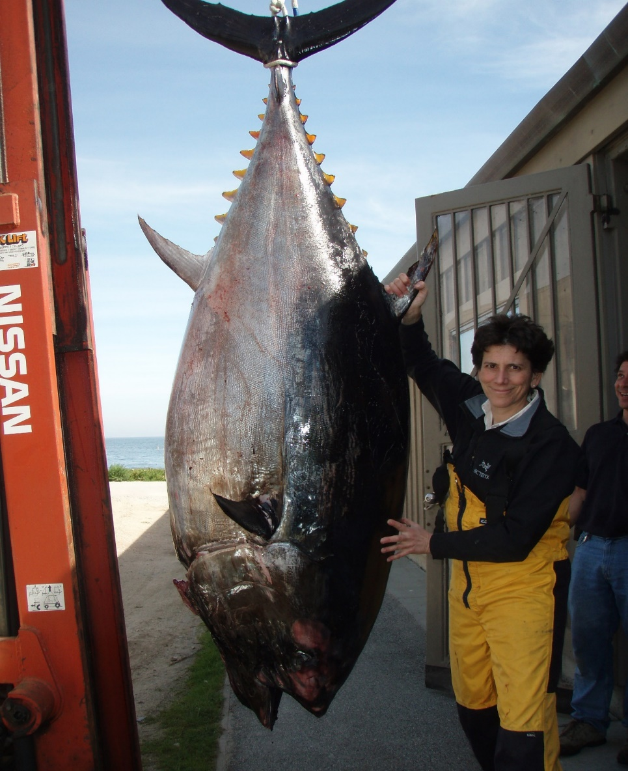
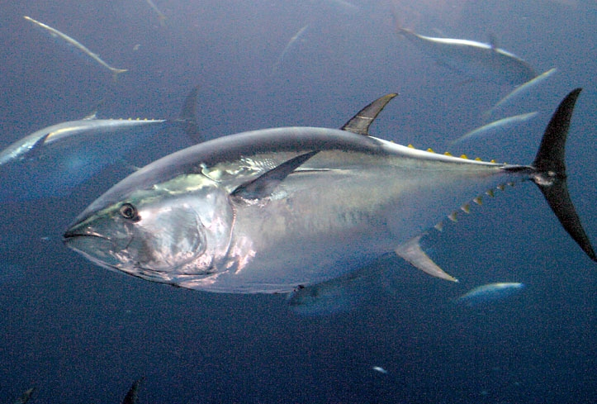
Tuna in Captivity at Stanford & Monterey Bay Aquarium
1994-2014

Slide 14
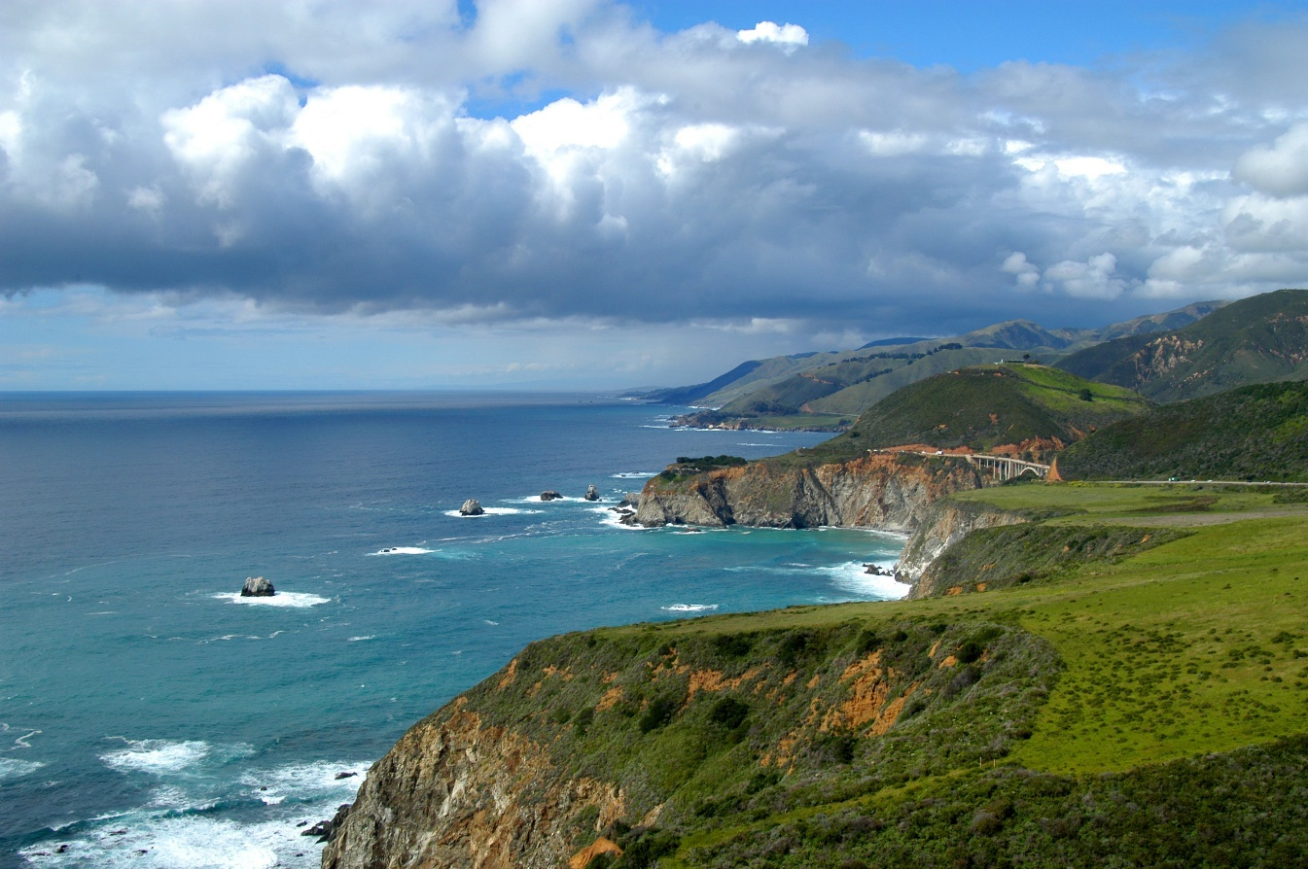
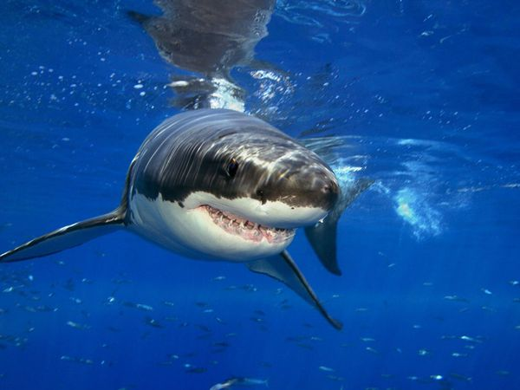
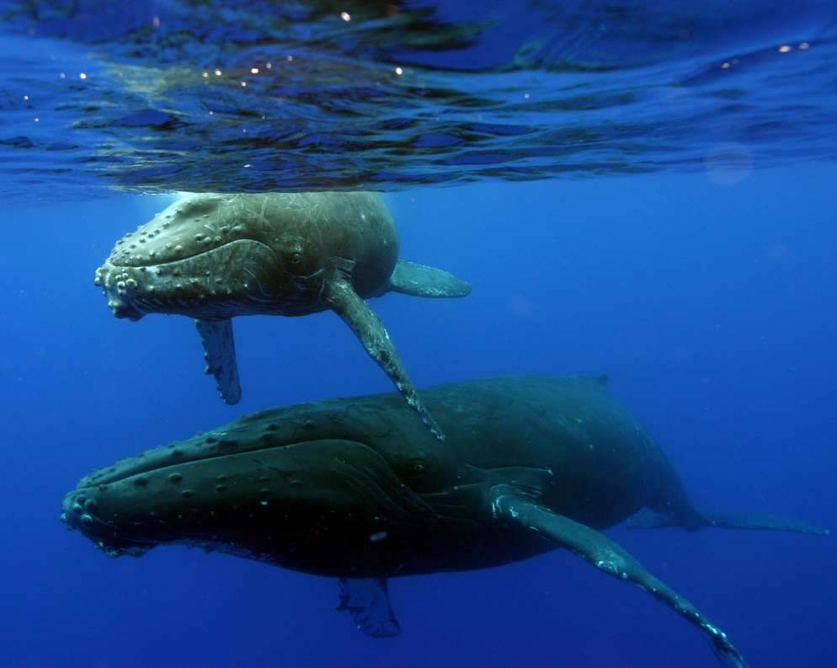
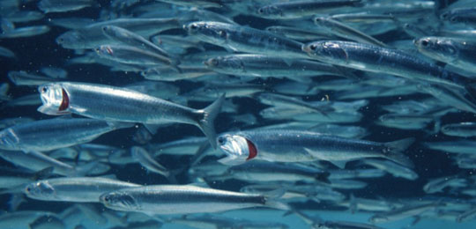
Who We are? We ask Big Questions:
Can We Monitor The California Current?

Slide 15
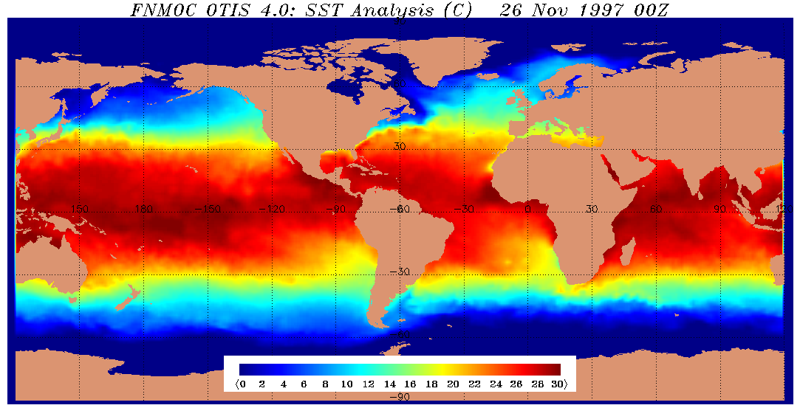
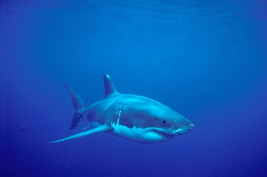
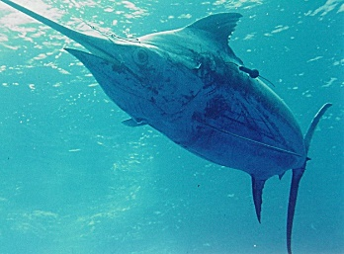
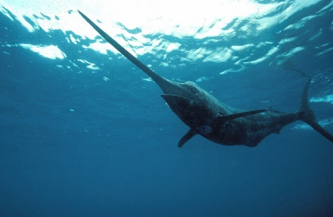
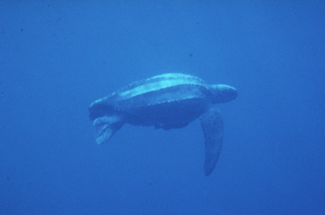
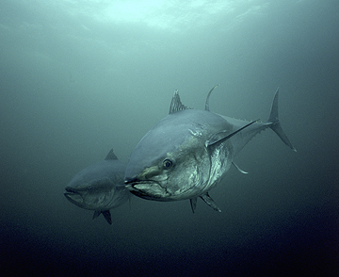
WHAT SCIENCE DO WE NEED?
Requires a Multi-Disciplinary Approach
Biology, Oceanography, Engineering, Informatics (IT), Models

Slide 16
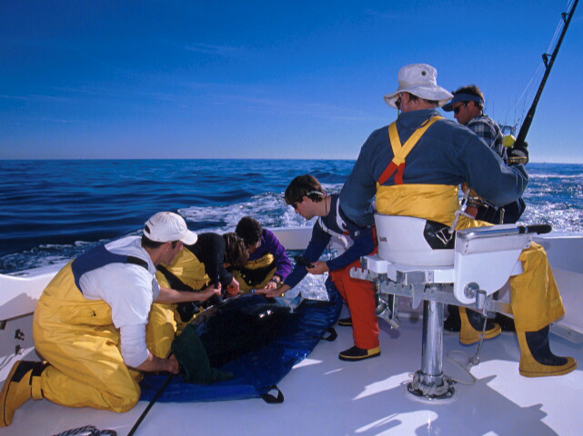
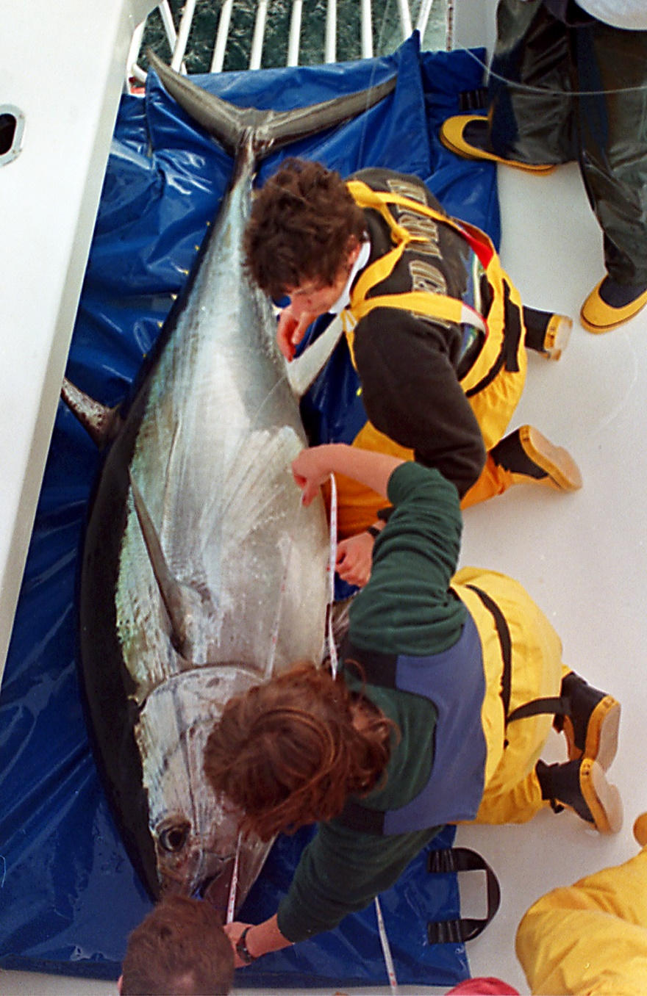
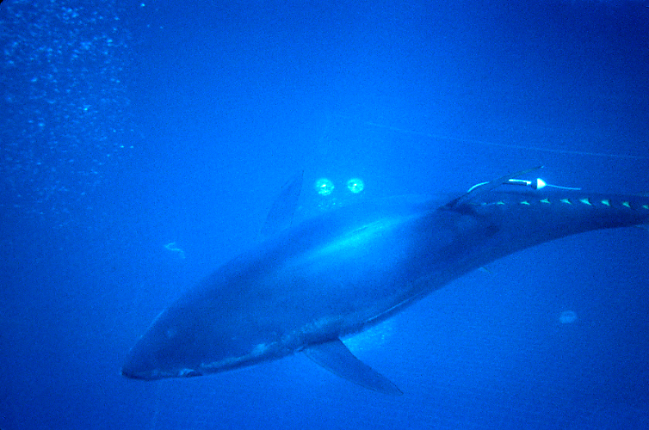

TAG A GIANT CAMPAIGN 1996-2015
~2000 Atlantic & Pacific Bluefin Tuna Tagged

Slide 17
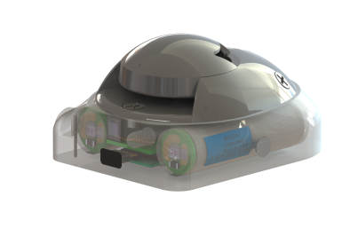
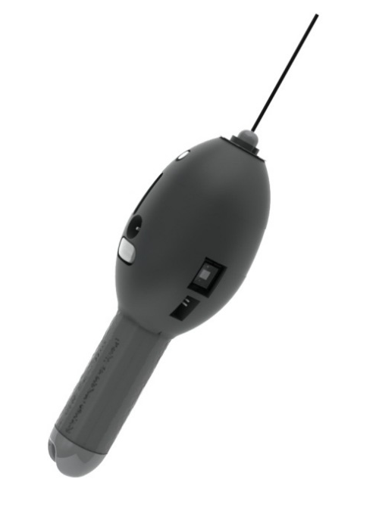

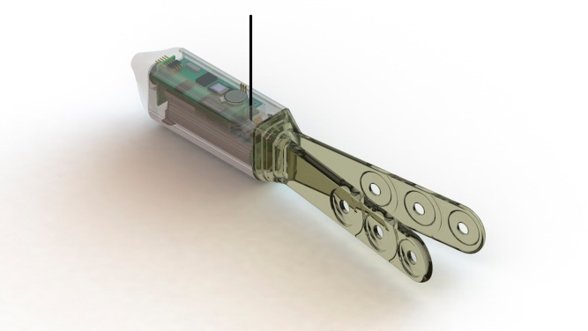
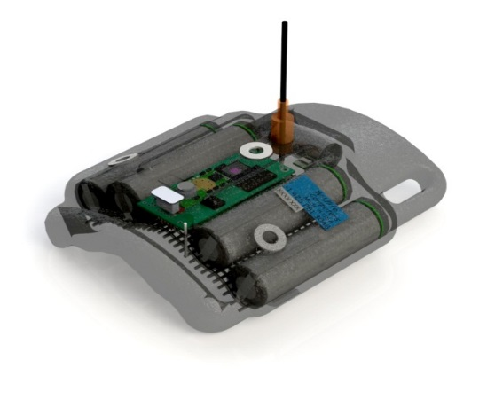
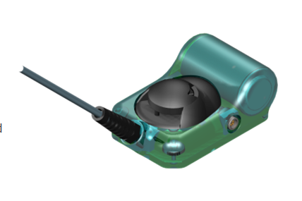
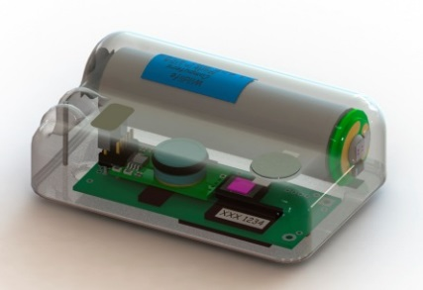
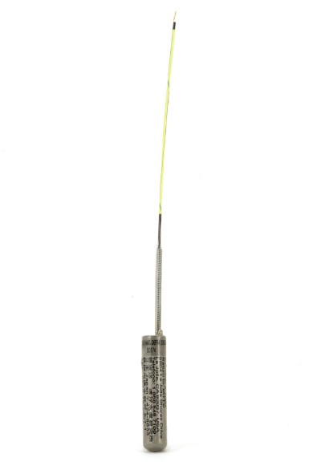
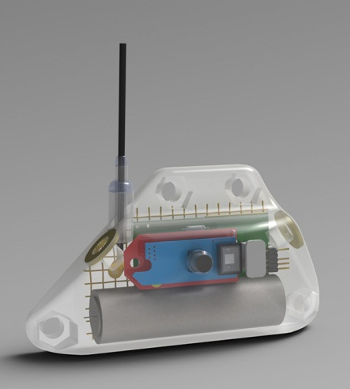









Conservation Technology: Ecosystem Monitoring With Animal Tags
“Environmental Intelligence”
SPOT
Single-point
Fin Mount
MiniPAT
Pop-up
Daily Diary
Turtle tag
Acoustic
Tags
Accelerometer
Archival
Tag
Fin Mount
Fastloc™ GPS
Slide 17
Wildlife
Computers
Notes:
17
Increasing Role for Biologging- But Not the funding required
17

Slide 18

Giant Bluefin: Tracking Animals that Remain Submerged
1997 Release

Slide 19




Archival Tags: Data Loggers
2mm
Teflon
Sensor
stalk
16-128 MBytes
Pressure, 2000m
Temperature –5ºC/40ºC
Light 470nm
Salinity
Real time clock
Physiology
Position
Oceanography
16 million readings
3.6 V Lithium
Batter

Slide 20


Bluefin: Tracking Animals that Remain Submerged
sunrise
sunset
local noon
1997 Release

Slide 21






Can Electronic Tagging Data Improve Bluefin Tuna Population Assessments? Mortality, Maturity, Population Structure, Life History
58,000
40,500 Days

Slide 22

Tags Provide Diving Behavior & Info on Environment

Slide 23

Can We Monitor Ecosystems?
Biologging (ARGOS)
Gliders/ Drones
Buoys
eDNA
Environmental
Monitoring for Oil?
Look for Eggs
Identify Genes that
Indicate exposure

Slide 24
Observing, Monitoring and Protecting the Blue Serengeti off Our California Shores
Tagging of Pacific Pelagics
Notes:
The California Current Pelagic Ecosystems Are some of the most Intact Ecosystems on the Planet and Today I am going to tell you about our Blue Serengeti Off the Shores of Monterey Bay

Slide 25












Pacific Bluefin Tuna Electronic Tagging Program
TOPP (ONR, Moore, Packard, & Sloan)
Monterey Bay Aquarium & Stanford University
Building a Marine Life Observing System:
Tracking Animals Should be A Part of IOOS
TAGGING OF
PACIFIC
PELAGICS
Notes:
In the Pacific we began most of the electronic tagging with the Tagging of Pacific Pelagics program a 10 year effort to tag large pelagics from 2000-2010. Over 1500 tunas were tagged in this period by Our team, IATTC and NOAA all funded by TOPP.

Slide 26







Argos Satellite Telemetry
Radio Telemetry
Position
Oceanography
Behavior & Physiology
Life History (mortality, survivorship data)
Population Abundance

Slide 27



Biologging: Tag, Track, & Monitor Marine Animals
Notes:
27
nix

Slide 28






Where are Windows of Optimal Habitat?
based on Cury and Roy 1989

Slide 29





Tagging Reveals Niche Utilization
Thermal Niche Separation: Albatross, Tunas, Sharks

Slide 30


TOPP Biological Hot Spots (Density) in the CCLME: Where the Predators (23 Species) Roam
North Pacific Transition Zone
California Current
White Shark
Cafe
Block et al Nature 2011

Slide 31




Can We Monitor Apex Predators in Real Time? Yes
Shark Acoustic Detection Buoy
Wave Glider
Robot that
Listens for
Sharks

Slide 32



Can We Monitor Sharks in our National Sanctuaries?

Slide 33





SharkNet: Live Shark Detection Buoys

Slide 34



White Shark at Detection Buoy-
Ano Nuevo Reserve, California

Slide 35





Acoustic Tags: Reliable Long Term Monitoring
Tomales Pt.
Pt. Reyes
Farallon Is.
Ano Nuevo Is.
Monterey Bay
Hopkins
Notes:
Focused at rookeries along the coast eating seals
Spend a lot time there then move directly to another rookery
We can also see exactly when they leave and when they return
In many cases if they are not at one rookery they are at another
The acoustic tagging project is in the initial stages

Slide 36

How Can We Now Leverage the Technology To rapidly use it in the Line Islands?

Slide 37




Monitoring Marine Protected Areas
We Need to Census Health and Residents
Subsea to Space Comms
MPA Environmental Monitoring
Active Wildlife Tracking & Anti-Poaching
©2012 Liquid Robotics, Inc. 1329 Moffett Park Drive, Sunnyvale, CA 94089, USA. All Rights Reserved.
37
Ocean Observation for Detecting Climate Change
Fish and Shark Tracking

Slide 38


Major Need for Surveillance Technology in Ocean
Will We know When Seascape Changes Occur?
Notes:
Ocean Ecosystems are Vastly complex, dynamic environments. Difficult to Understand the Nature of Stability, Trophic linkages and Energy Flow

Slide 39



Monitoring MPAs With Biologging Technology
Environmental Intelligence
Know What your Protecting
Long-term Census
Map Dynamic Nature of
MPA Animal Movements (Tuna
Versus sharks)
Active Management
Iridium/Cell Enabled Buoys
Predictive models from tag
Movements
Mobile Gliders Patrols
Ocean Observing
Vessel Intrusion Monitoring
-
Notes:
Oceans are under intense pressure to satisfy expanding demands e to population growth
Climate Change poses unknown threats to marine Ecosystems
Requires monitoring

Slide 40


What If?
You could Census MPA Residents Remotely?
Know how Tunas and Sharks Utilize the Atolls/Islands
Know the Residents Schedules by Tides, Daily, Seasonal, Annual Timescales
Continuously Collect Data on Animal Activity
Have Remote Photo Surveys of MPA
Have Surveillance for illegal Fishers Presence

Slide 41

Large MPAs Require Technological Solutions for Monitoring

Slide 42
Stanford Researchers
Are in the Line Islands
Palmyra Consortium
PIPA Oceanography (SEA)
Surveys of Caroline, Malden, Christmas and Fanning
Oceanographic Data

Slide 43


Examples: Palmyra-Kingman Reef in Line Islands
MPA Remote “Live” Pelagic Monitoring Experiment
Lagoon
Reef
Channel
Pelagic
Notes:
43
See divisions in aerial shot

Slide 44

Live Buoys Tracking Mantas at Palmyra Channel

Slide 45


We Have Measured the structure
on coral reefs in Line Islands and Continue to do so
average biomass (kg/200 m²)
0
heavily fish
fished
unfished
Stevenson, Micheli, Block et al. 2007 Coral Reefs
Notes:
45
45
Made mention of this before – extremely abundant biomass of large predators – these are things that are vulnerable in other systems and lost. Superb place for asking questions about the ecological improtance of large predators – but it is so good that it is weird. As in many intellectual contexts – the focused study of aberrant structured systems can be incredibly insightful

Slide 46




Inverted trophic pyramid
At Uninhabited Line Islands
}
A “pristine” baseline?
Notes:
46
“Pristine”not just loos of these spp, but loss of some fundamental interactions that allow
Possible explanation properties of trophic transfer efficiency is wrong; basic laws of thermodynamics have been circumventred or – we are somehow looking at this system the wrong way.
What I got to wondering was whether we were looking at these systems with eyes accostemed to seeing and studying coral reef communities in HI, FL, and carriebean where there large bodied predators were gone or one the way about the time that we started doing ecology underwater.
Tools were developed in these other contexts

Slide 47



Large predator sampling: stable isotope analyses
Lutjanus bohar
Carcharhinus amblyrhynchos
Carcharhinus melanopterus
Notes:
Chose 3 most common large predators. 2 sharks and 1 equally toothy telost predator. all sampled in the reef environemnt. Make up 85% of large fish biomass. Sampled all of these predators in the reefs where fish surevys had taken place

Slide 48


Isotopes Reveal Mobile mega-fauna energetically link distinct communities
Pelagic
Reef
Lagoon
Notes:
48
48
Mirror invert
Way we go about mapping – most iformative for looking @ spatial coupling has been C13
Convienently gradient of C13 more negative values obtained moving; owing to difference in carbon fixation of primary producers in these different systems. Use these signals to determine where predators eating and thus which communities they connect

Slide 49

Mobile top predators draw energy from neighboring communities
Notes:
49
Mixing model that uses a bayesian framework to quantitativley interpret these patterns incorporate error structure around isotopic measurements of predators and commnity source values and estimate the contributions of sources to a predator. Outputs posterior probability distribution tell us what predicted contribution from different sources to a focal species – or essentially how much of its biomass is predicted to have been built from the different energy sources you identify. Higher values represent the most important source contributions.
Examine blacktip. Well behaved reef fish. ~90reef, 10 lagoon, very small fraction from offshore.
Other end of spectrum is grey reef. Only ~10 reef environmet. Around 90% energy comes from.
Help visualize these connections – think about their significance to conservation to ecology or conservation.
Example application to conserve: consider grey reef. Much talk about ES based management practice habitat based management. Coral reef reserve under assumption we are protecting a coral reef community. Draw a boundary around these systems and then harvest as usual (or potentially intensify) in these external areas. data tells a grey reef shark would not profit from such a policy. 2nd most abundant fish in the reef (biomass). Uses and needs energy from the pelagic environment. Unless we realize these cryptic linkages exists scrathc our heads as grey reefs disappeared from our system. Scratch our heads sharks numbers in these reserves dropped. Loss of the animal – this predator improtant extra-consumptive ties to these systems that would be lost

Slide 50

Twenty Years of Ocean
Data Stanford and SEA
This Year (2015) was Warmest Ever measured

Slide 51








Chagos Tagging of Pelagics
(Can we Partner?)
Observing, Monitoring and Protecting MPA Ecosystems

Slide 52





Notes:
Tagging platform
52

Slide 53




Tagging Reports

Slide 54

Local Movements: Silver Tip with an Acoustic Arrays

Slide 55


Slide 56






The Frontier: New Technology for Improving Ocean Monitoring
Satellites Ships Ocean Buoys Gliders Camera Tags

Slide 57






Developing Real Time Monitoring Tools
Shark Acoustic Detection Buoy
Notes:
The simple quesiton is Can we monitor Apex predators in real time- can we build a “wired ocean”

Slide 58




Shark “Fin Alarm” Tag
Will Provide protection for Sharks within an MPA

Slide 59





Ocean observation Buoys
Satellite & Cell Tower
Enabled comms
Hydrophone

Slide 60

Suggestions for the PIPA MPA
Employ Gliders for Monitoring
Anti Poaching Strategy
©2012 Liquid Robotics, Inc. 1329 Moffett Park Drive, Sunnyvale, CA 94089, USA. All Rights Reserved.
60

Slide 61


Experimenting With Continuous Monitoring Techniques
Notes:
The glider used was called Carey after Frank Carey- and is equipped with a weather station and VR2C Vemco receivers integrated with the
Glider controller to provide irridium uplinks of real time detections- so within 5’ or so.

Slide 62

Integrated Acoustic Receivers on Mobile Gliders
Notes:
Test one was at Ano nuevo – December 2011- shown here is loweirn gthe glider with the VR2C cabled into the controller of the glider-and a independent VMT tag

Slide 63


Maritime Domain Awareness
Persistent, Wide Area Surveillance
Liquid Robotics Wave Glider

Slide 64





Slide 65


We’ve developed Capacity in Monterey Sanctuary that can easily be Moved to Line Islands- tested in remote locations already
2012
South Farallon Island
2012
2011
2013
Notes:
Three missions were conducted 2011- Ano nuevo, 2012 along the central coast of California to Eureka- and mission three to the channel islands

Slide 66


TOPP: Animals as Ocean Sensors
E-Seal Foraging Distribution
E- Seal Is a Low Cost Hydrographic Profiler
From Robinson et al.
PLOS one 2012
Data Management

Slide 67



Live Line Island App
Notes:
Shark net

Slide 68



PIPA As A Global Leader
Develop a Comprehensive Chagos Electronic Monitoring Plan
Discern Size of MPAS for Tunas/Sharks
Develop Major Initiative to Demonstrate MPA Remote Monitoring Technology
Showcase Technology for Globe
Strategic Investments

